Slide 1
ALLERGIC CONJUNCTIVITIS
1. Allergic rhinoconjunctivitis
2. Vernal keratoconjunctivitis
3. Atopic keratoconjunctivitis

Slide 2
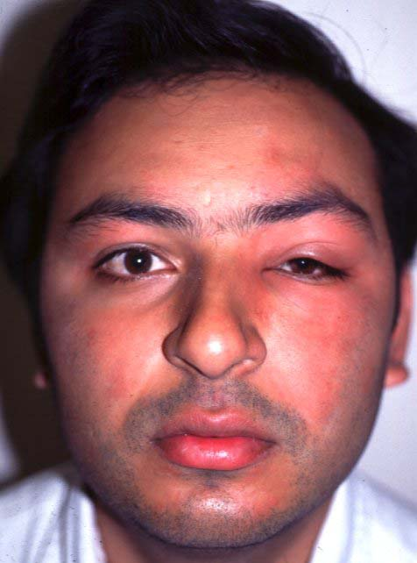
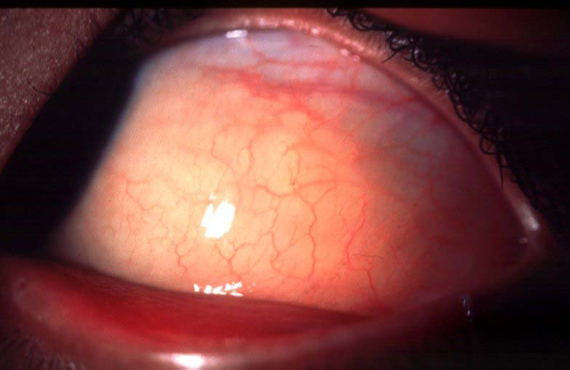
Allergic rhinoconjunctivitis
Hypersensitivity reaction to specific airborn antigens
Frequently associated nasal symptoms
May be seasonal or perennial
Transient eyelid oedema
Transient conjunctival oedema

Slide 3
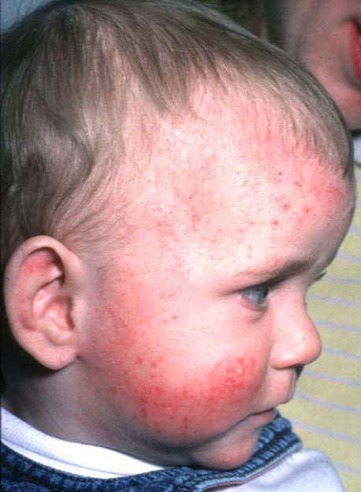
Vernal keratoconjunctivitis
Frequently associated with atopy: asthma, hay fever and dermatitis
Recurrent, bilateral
Affects children and young
adults
More common in males
and in warm climates
Itching, mucoid discharge
and lacrimation
Types
Palpebral
Limbal
Mixed
Treatment
Topical mast cell stabilizers
Topical steroids

Slide 4
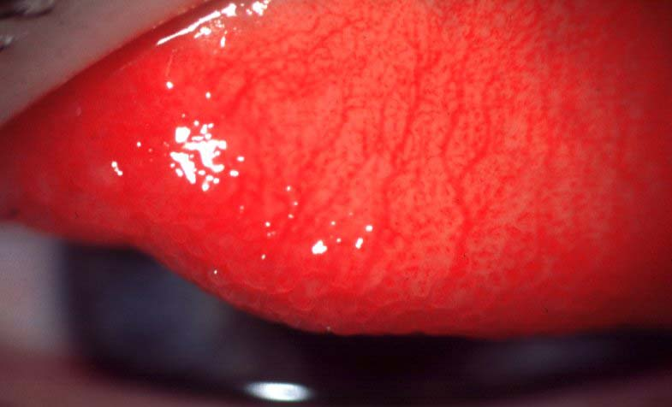
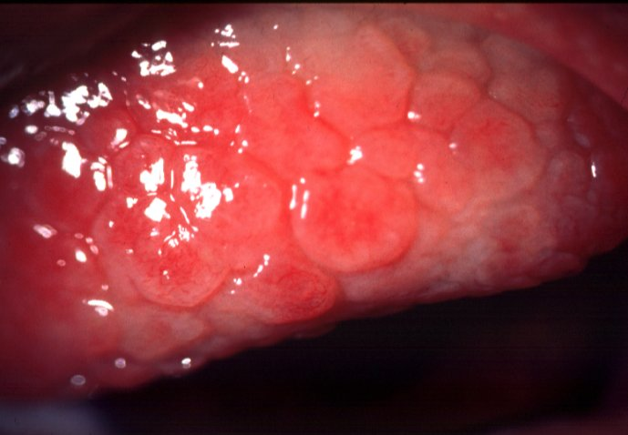
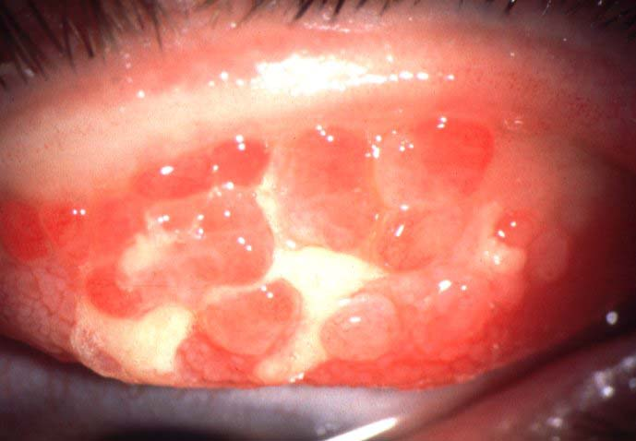
Progression of vernal conjunctivitis
Diffuse papillary hypertrophy, most marked on superior tarsus
Formation of cobblestone papillae
Rupture of septae - giant papillae

Slide 5
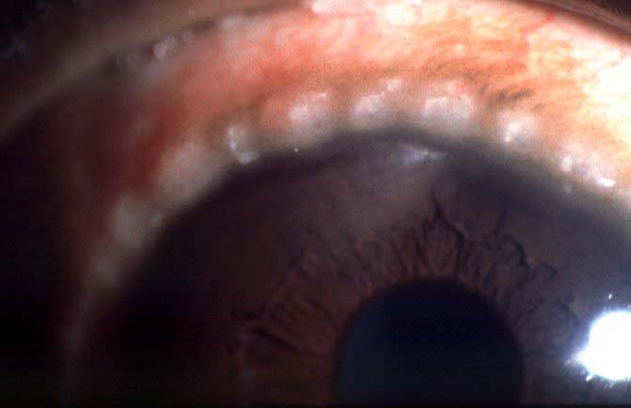
Limbal vernal
Mucoid nodule
Trantas dots

Slide 6
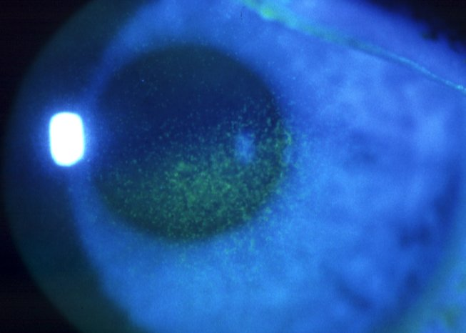
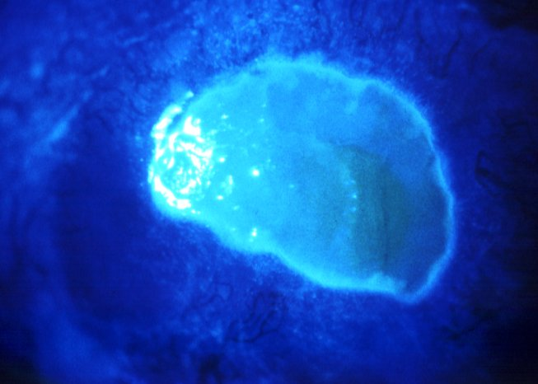
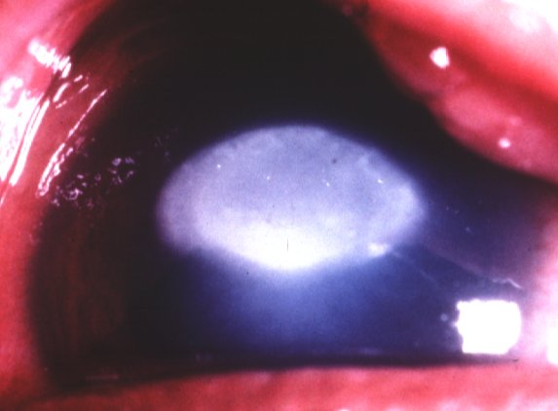
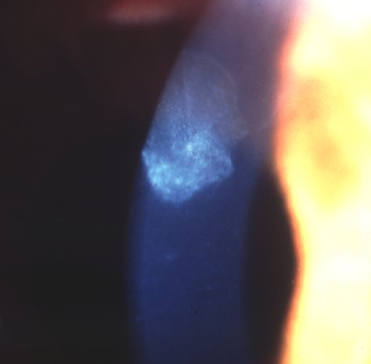
Progression of vernal keratopathy
Punctate epitheliopathy
Epithelial macroerosions
Plaque formation (shield ulcer)
Subepithelial scarring

Slide 7
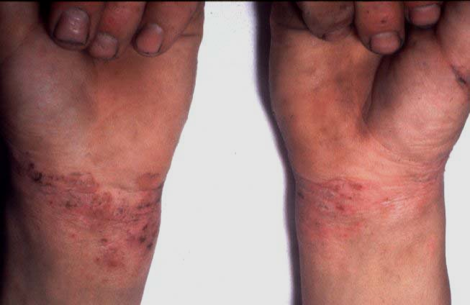
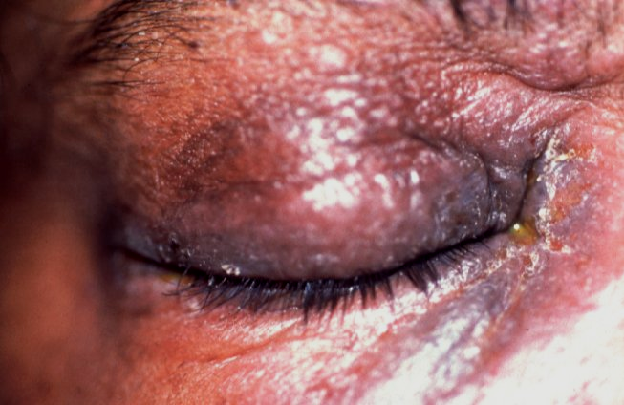
Atopic keratoconjunctivitis
Typically affects young patients with
atopic dermatitis
Eyelids are red, thickened, macerated
and fissured

Slide 8
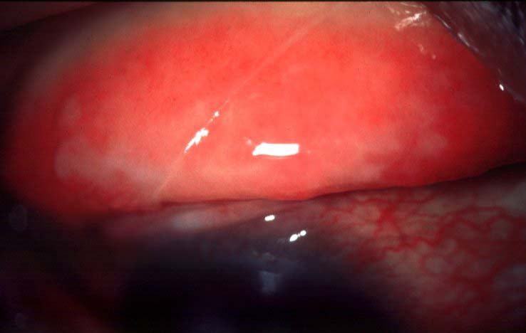
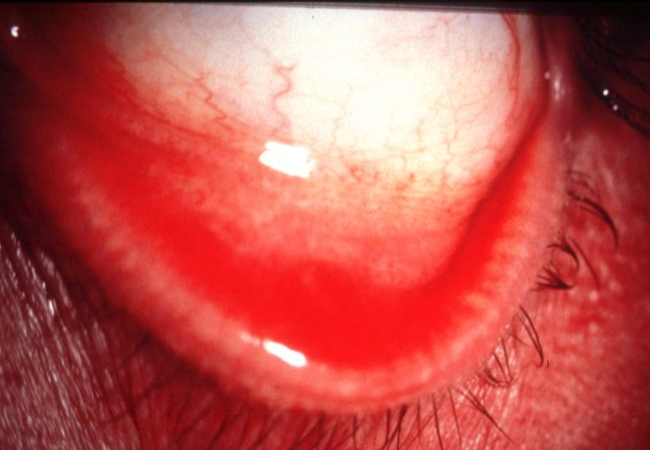
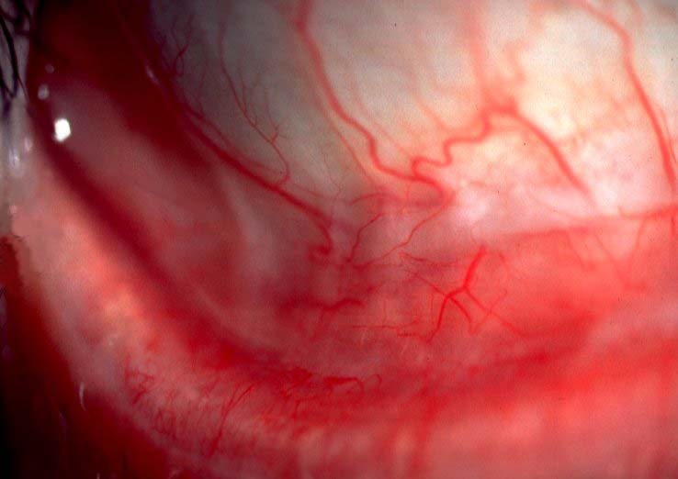
Progression of atopic conjunctivitis
Infiltration of tarsal conjunctiva causing featureless appearance
Inferior forniceal papillae
Mild symblepharon formation

Slide 9
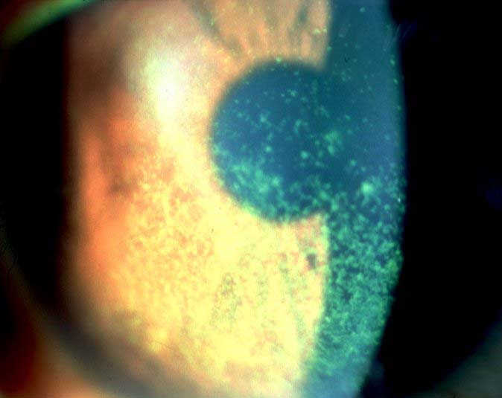
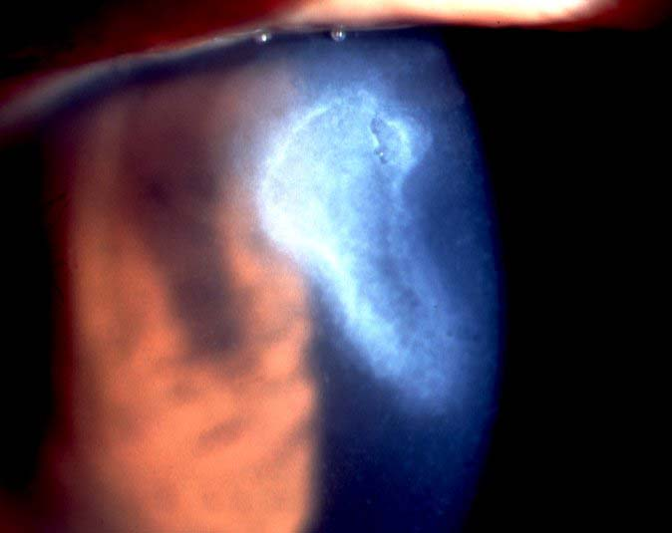
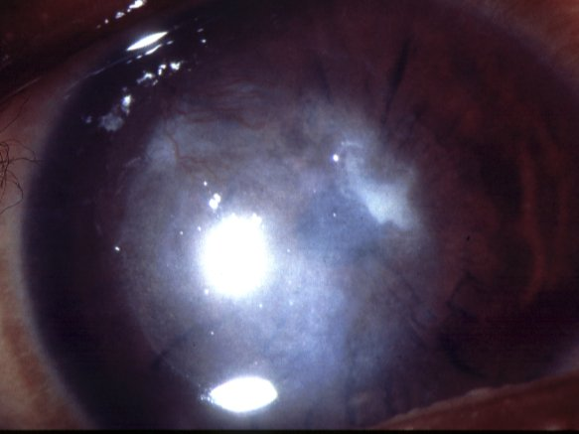
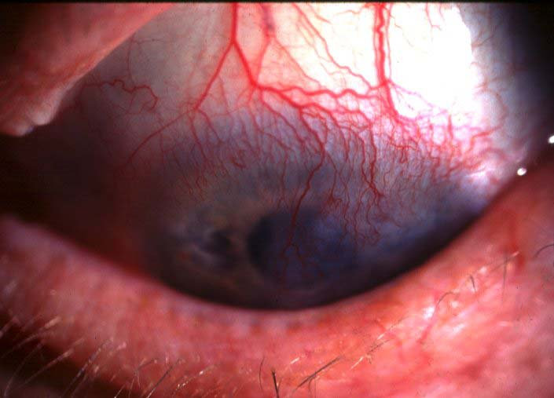
Progression of atopic keratopathy
Punctate epitheliopathy
Persistent epithelial defects
Subepithelial scarring
Peripheral vascularization

